Slide 1
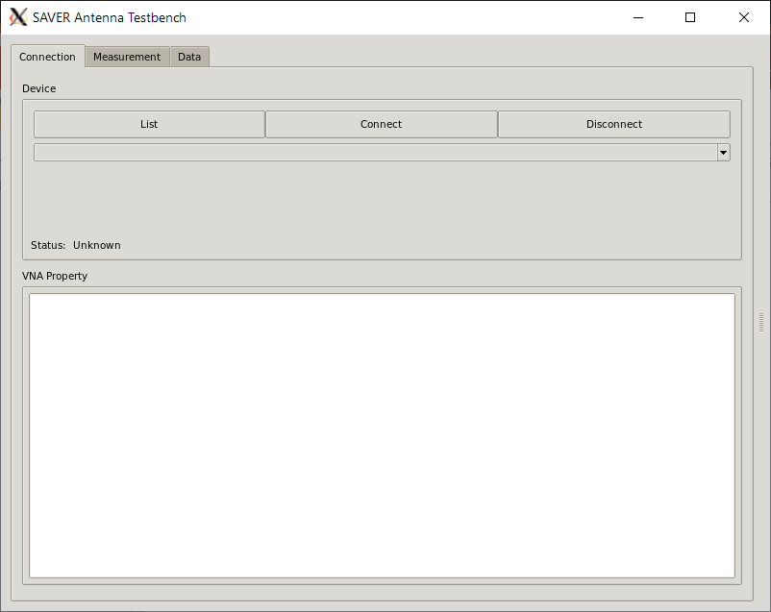
Step8.1
Step8.2
Step8.3

Slide 2
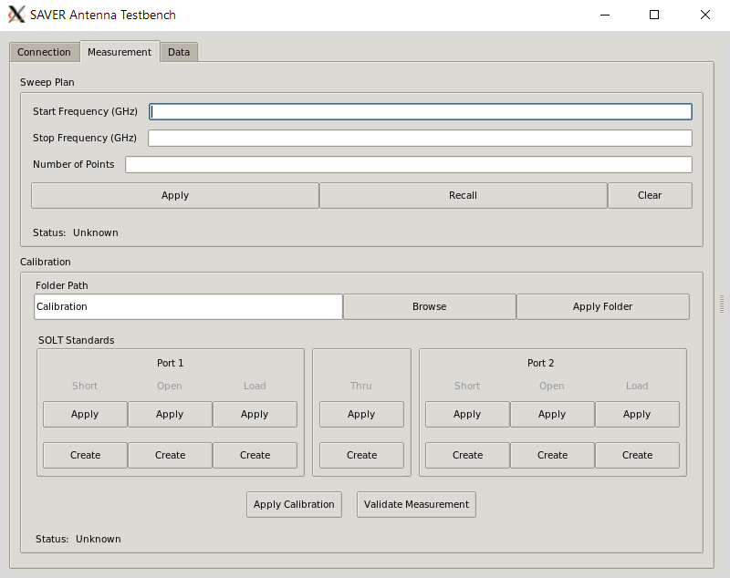
Step9.1
Step9.2
Step10
Step11
Step12

Slide 3
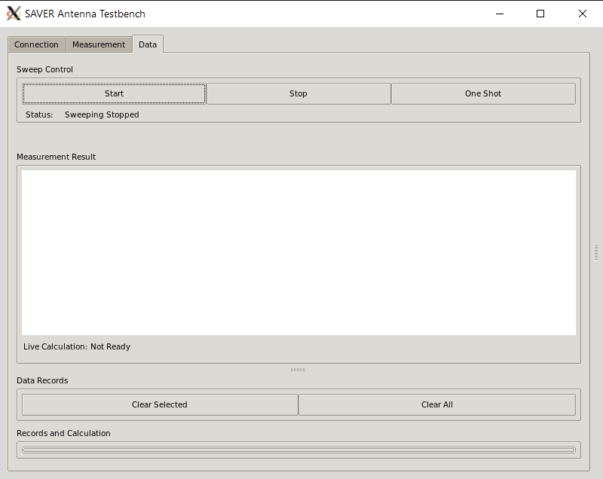
Step13

